Slide 1
Developing .NET Core app for Kubernetes
Uladzimir Abramchuk May 2018

Slide 2


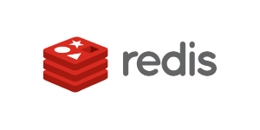







Why?
x15

Slide 3

Docker
Docker is a container technology for Linux that allows a developer to package up an application with all of the parts it needs.

Slide 4
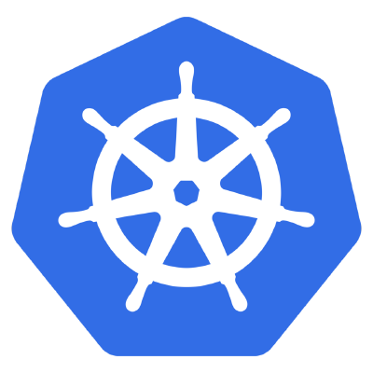
Kubernetes
Kubernetes is an open-source system for automating deployment, scaling, and management of containerized applications.

Slide 5



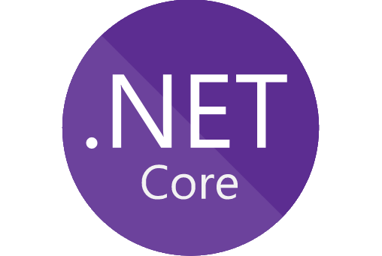


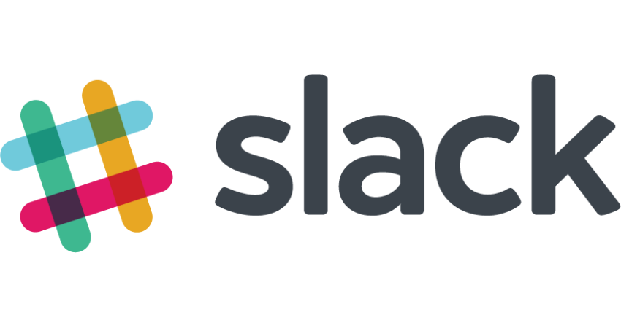
Big picture

Slide 6
Development

Slide 7

API first
Your API is the first user interface of your application
Your API comes first, then the implementation
Your API is described (and maybe even self-descriptive)

Slide 8
Swagger
Generate clients (and server):
NSwag
Swagger codegen
Test API against spec: Dredd
Swagger UI
Lib: Swashbuckle

Slide 9
Docker image
Use as few layers as required
Use a stripped-down base image
Use the right image for the right service
Fewer apps in image mean fewer bugs and vulnerabilities
Base image: Alpine

Slide 10
Documentation
Markdown
Build artifact
readthedocs.org

Slide 11

Artifacts versioning
Docker image (and application inside)
Helm chart
Documentation
Tool: GitVersion

Slide 12


Repository manager
Nuget, npm, docker registry
Caching
Proxy
Swagger-generated clients
Tools: Nexus

Slide 13

More
Docker-compose for dependencies / single-node cluster in future
Fix SDK version in global.json
Fully automated CI/CD pipeline (GitLab, Octopus)

Slide 14
Hosting

Slide 15
Health checks - Readiness probe
When a Container is ready to accept traffic.
Possible scenarios:
Configuration
Migrations
Shutdown
Etc.

Slide 16
Health checks - Liveness probe
When to restart a Container
Possible scenarios:
Backing services (like DB) are available
App is not deadlocked
Etc.

Slide 17
Health checks
Libs:
dotnet-architecture/HealthChecks
App Metrics

Slide 18
Resource limits
If a Container exceeds its memory limit, it might be terminated
If a Container exceeds its memory request, it is likely that its Pod will be evicted whenever the node runs out of memory
A Container might or might not be allowed to exceed its CPU limit for extended periods of time

Slide 19
API gateway
An API gateway sits between clients and services. It acts as a reverse proxy, routing requests from clients to services.
SSL termination Authentication
IP whitelisting Client rate limiting (throttling)
Logging and monitoring Response caching
Web application firewall GZIP compression
Servicing static content
Host, base path, scheme as custom headers (X-Proto-...)
app.UserForwardedHeaders()

Slide 20
API gateway
Host
Base path
Forwarded headers
Discovery
Tools: Kong, istio

Slide 21
Visibility

Slide 22
Monitoring

Slide 23
Monitoring
Prometheus format
Monitor requests on API gateway (proxy)
Libs:
Nexogen.Libraries.Metrics.Prometheus.AspCore
App Metrics

Slide 24
Logging

Slide 25
Logging
stdout
Structured logs
JSON
Correlation ids
If your service can only write logs to file system use sidecar (or process) with tail
Lib: Serilog

Slide 26
Tracing

Slide 27
High availability

Slide 28
Graceful shutdown
All of the resources app used and all of the traffic and/or data processing that it handled are closed and released properly.
SIGTERM
Finish ongoing requests
Do not accept new requests

Slide 29
Graceful shutdown
ASP.NET Core:
Microsoft.AspNetCore.Hosting.IApplicationLifetime
.NET Core:
System.Runtime.Loader.AssemblyLoadContext.Default.Unloading

Slide 30
Multiple instances
Session and Cache - use distributed cache (like Redis)
Cookies - configure Data Protection or switch to access tokens
File system - make sure files are persisted to shared storage

Slide 31
Resilience
Retries with exponential backoff
Work around network timeouts
Circuit breaker
Fallbacks
Prefer async communication over long chain of sync HTTP requests
Lib: Polly

Slide 32
Security

Slide 33
Read-only file system in container
.NET Core 2.1
Disable diagnostics:
COMPlus_EnableDiagnostics="0"
Store files in folders backed by shared storage
Debug may become more complex

Slide 34
Run container as non-root user
Root user in container is root user on host
Specify user id to run container with
Do not forget about permissions

Slide 35
Secrets
Use secrets for sensitive information
Kubernetes secrets passed to container as environment variables or files

Slide 36
Q&A

Slide 37
Thank you

